Slide 2
ART SPIGELMAN
Art Spiegelman was born in Stockholm, Sweden
(15.2.1948) is an american comics artist.

Slide 3
Der Pulitzer-Preis
He is best known for his Pulitzer Prize- winning comic book memoir, Maus. A Survivor's Tale. (1992)

Slide 4
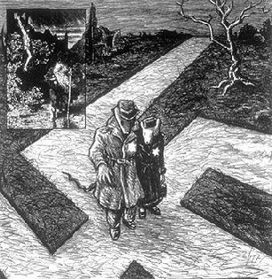
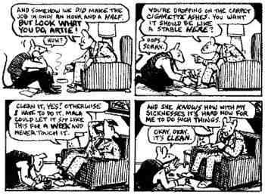
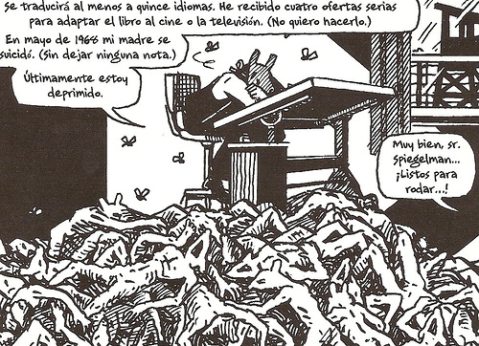
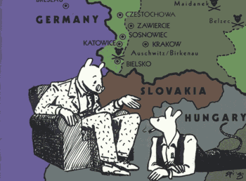

Slide 5
A BIOGRAPHY OF THE AUTHOR'S FATHER
Maus is a story within a story: Art Spiegelman, the son of two survivors of the Holocaust, tells how he interviewed his father Vladek about his father's Holocaust experience, and he also tells the story of the father's persecution and survival.

Slide 6
HOLOCAUST
Most art and literature about the Holocaust is governed by certain unspoken rules. Among these are the notions that the Holocaust must be portrayed with the utmost seriousness, so as not to obscure its enormity or dishonor its dead. In what way does Maus obey, violate, or disprove these "rules"?.

Slide 7
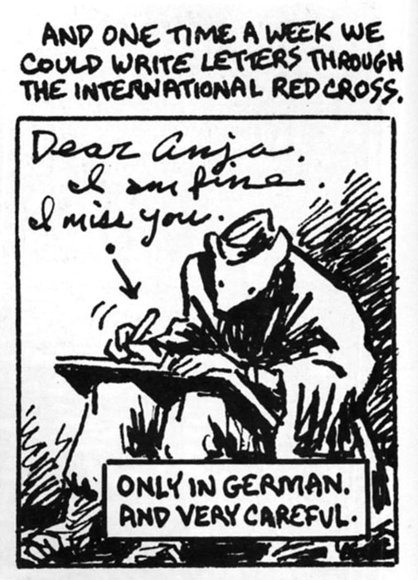
ANIMAL FABLE
Fables are short narratives that use animal characters with human features to convey folk wisdom and to help us understand human nature and human behavior.

Slide 8
Maus is written in a comic book format, with various types of animals representing the various nationalities and religions: Jews are generally mice, no matter what nationality they are.

Slide 9
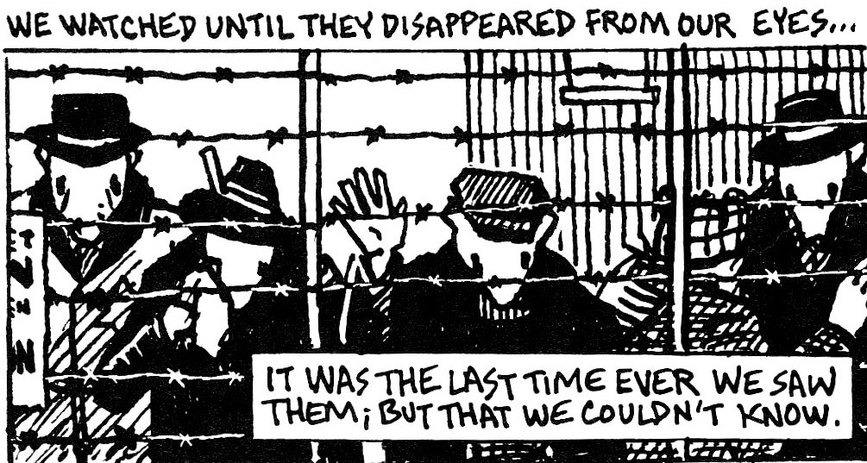
TO START WITH
The book starts with this disturbing quote.
What does pretend the author achive with this quote?

Slide 10
1938. WHAT HAPPENED IN GERMANY?
Spiegelman’s parents traveled from Poland to Czechoslovakia through Germany
A Jewish traveler told them what he had heard about what happened in Germany
What is a Pogrom?
The traveller expressed his desire.
What did he desire?
What really happened?

Slide 11
Chapter 4: The noose thightens.
Why do the Germans hang Nahum Cohn and his son? What effect does this hanging have on other people?
How does Vladek feel about the hangings? Why does he feel this way?
Who are the Jewish police? Why is Art surprised to hear about the Jewish police?
Do Anja’s grandparents go to Theresienstadt in Czechoslovakia? What happens? How does Vladek find out?

Slide 12
PARA CONCLUIR
Maus retrata el Holocausto o un genocidio. Un genocidio es la destrucción deliberada y sistemática de un grupo cultural, racial o político. ¿Conoces algún genocidio reciente? ¿En qué se asemejan al Holocausto? ¿En qué se diferencian?
¿Qué le ocurre a la gente que vive bajo un régimen de terror durante un largo periodo de tiempo? ¿Pueden las personas adaptarse a un régimen del terror?
El Holocausto nazi se dio bajo un régimen totalitario en el que no existían mecanismos de control al poder: ¿crees que hoy podría darse en nuestra sociedad un régimen autocrático?

