Slide 1
MYTHS
A magical way of explaining the world.

Slide 2
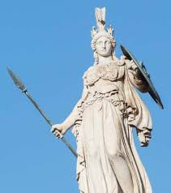
Before philosophy and science, our ancestors used myth and magic to answer questions about reality using imagination and fantasy.

Slide 3
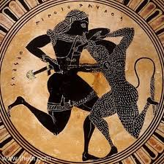
A myth is a story that explains the origin of a particular reality:
This reality can be:
Social, such as a wedding celebration or electing political leaders
A physical phenomenon, such as a storm or the change of seasons occurring during the year.
The universe as a whole: how it originated or when it will disappear.

Slide 4
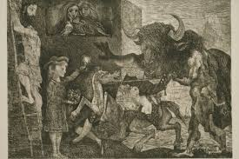
These stories adopt an intellectual attitude with the following characteristics:
An essential role is assigned to the gods and links natural phenomena to their wishes.
The belief that divine will can be changed through rites in honour of the corresponding god.
Destiny is understood as cosmic force. This force imposes events that cannot be understood by human beings.

Slide 5
MYTHS
This way of thinking meant that magic and rites were ways to explain all the inexplicable aspects of life and nature.
Myths have their origin in the emotional and imaginative activity of humans.
The explanations are based on supernatural elements.

